Slide 1
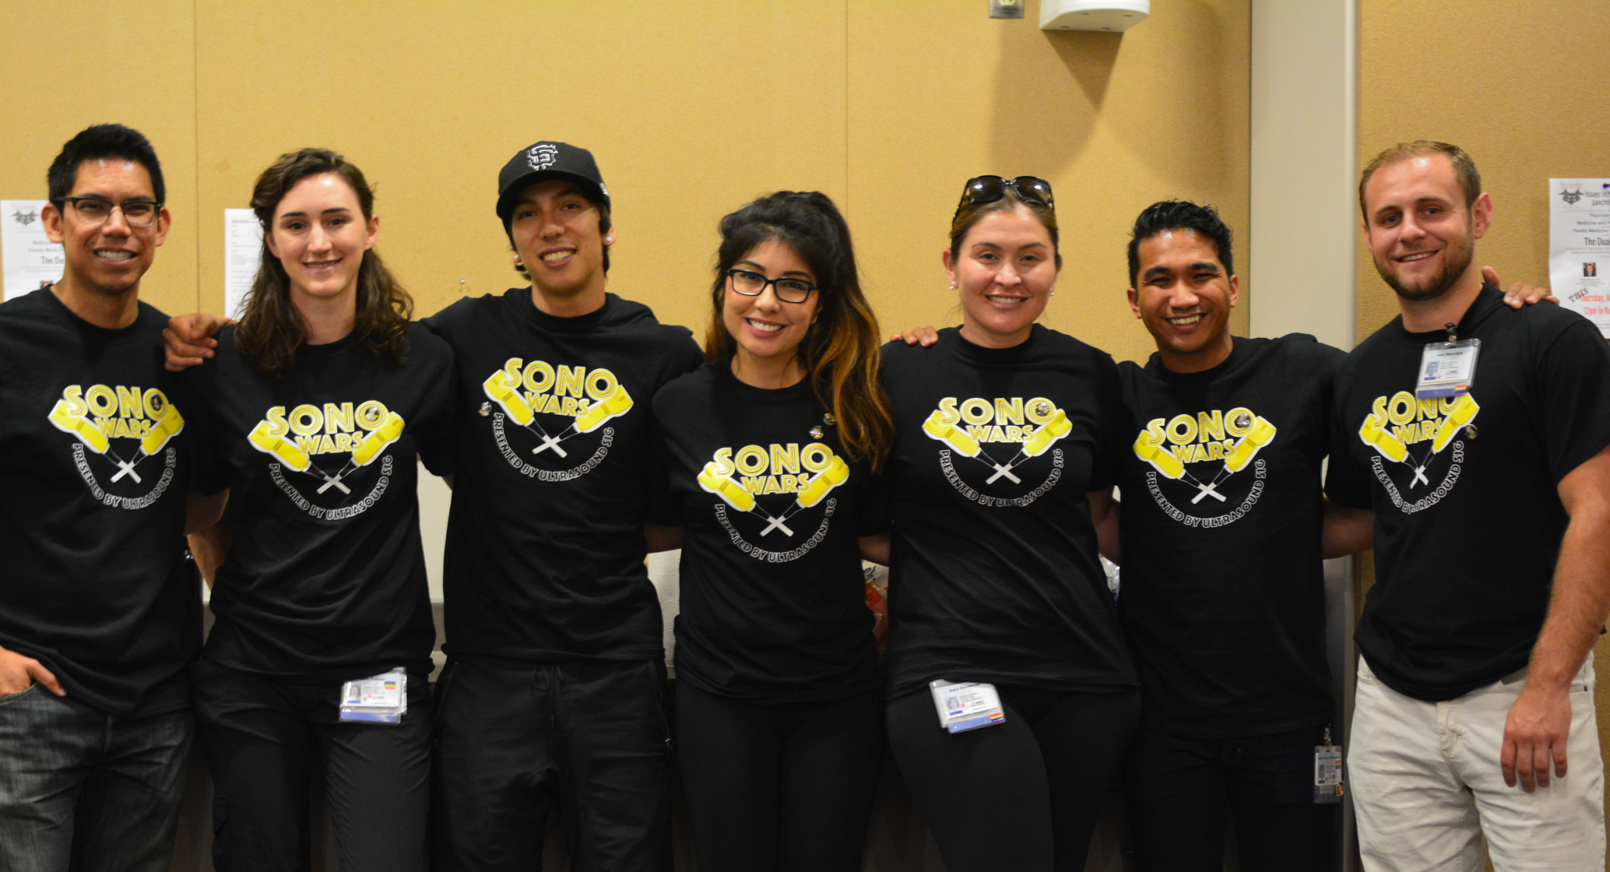
Evaluating the Utility of Ultrasound Training in Medical Education: A Pre- and Post- Survey Analysis
Ivan V. Shevchyk¹, Chris E. Silva¹, John-Lloyd C. Santamarina¹, Nika R. Carrillo¹, Aska B. Sturdevan¹, Sarah E. Medeiros², MD, MPH, Michael A. Schick², DO, MA
University of California Davis, School of Medicine¹, UC Davis Medical Center; Department of Emergency Medicine²
Introduction:
Ultrasound is a rapidly evolving diagnostic and procedural tool, increasingly utilized across a number of medical specialties.¹ Concurrently, there has been a growing number of medical schools in the United States integrating ultrasound training in their curricula.^{2,3} According to Bahner et al., as of 2014, 62% of U.S. medical schools have included ultrasound training as part of their undergraduate medical education.⁴ Previous studies have shown that medical students exposed to ultrasound generally had positive feedback on the benefit of having the course, and demonstrated improvement in various aspects of their training, including anatomy, physical exam skills, and preparation for clinical rotations.^{5,6}
Conclusions:
Students report a positive response towards ultrasound technology as a means of enhancing their educational experience.
Students reported increased confidence using ultrasound technology and an improvement in their ability to interpret ultrasound images.
General level of interest and inclination to establish supplementary ultrasound courses remained high during both pre- and post- surveys, suggesting that students did not view ultrasound as a detriment to their curriculum.
More than 80% of students agreed that ultrasound enriched their anatomy instruction.
Overall, students view ultrasound as a powerful instructive tool that could be used to further expand their current medical training.
Study Goals:
To date, no research has been conducted at a California medical school, evaluating first year medical students’ opinions on the effectiveness and value of their current integrated ultrasound curriculum. This study surveyed first year medical students to evaluate their confidence and perceived proficiency in bedside ultrasound skills following three integrated anatomy-ultrasound courses.
Figure 1. Student survey on their general interest level in ultrasound education.
Limitations:
Relying on voluntary participation; self-reported data.
Survey administration may have caused a self-selection bias and affected the number of responses received.
Prior ultrasound experience was not accounted for.
Confounding factor: students with prior experience may have an inherent bias towards integrating or omitting ultrasound within medical curricula due to their skill level.
Experimental Design:
A five-question survey was administered to first-year medical students at UCDSOM. The survey gauged, on a scale from one through ten, students’ general interest in ultrasound education, confidence using an ultrasound, ability to interpret ultrasound imaging and desire to incorporate further education in their preclinical years. At the beginning of the school year, a pre-ultrasound survey was administered to 54 first-year students prior to any formal ultrasound education. A follow-up survey was administered to 71 students after they were exposed to ultrasound curriculum in their anatomy course. Student responses were voluntary in both cohorts. Survey administration was online and in-person.
Figure 2. Student survey on their confidence using ultrasound technology.
Future Goals:
Use data to promote additional ultrasound integration at UCDSOM.
Increase exposure to ultrasound as a learning device and provide opportunities to improve on-going research.
Continue to investigate the utility of ultrasound in pre-clinical years and how to effectively provide ultrasound education in future courses.
More robust data can encourage academic leadership to establish ultrasound as a standard instructional device to enhance current curriculum.
Results:
Overall, after going through the formal ultrasound curriculum, student’s survey responses showed an improvement in all areas.
Table 1. Pre and Post-Ultrasound Responses and Analysis
Figure 3. Student survey on their ability to interpret ultrasound images of major organ systems.
Question Topic | Pre-Ultrasound Mean | Post-Ultrasound Mean | Percent Change | p-value
General interest | 7.74/10 | 8.37/10 | +8.1% | p = 0.06
Confidence | 2.41/10 | 3.89/10 | +61% | p = 0.0002
Ability to interpret | 1.96/10 | 3.99/10 | +104% | p < 0.0001
Desire for additional education | 8.02/10 | 8.31/10 | +3.6% | p = 0.41
Integrating ultrasound in anatomy enriched my education | 69.6 % Agree | 83.1% Agree | +3.5% | p = 0.12
References:
1. Bahner DP, Adkins EJ, Hughes D, Barrie M, Boulger CT, Royall NA. Integrated medical school ultrasound: development of an ultrasound vertical curriculum. Critical Ultrasound Journal. 2013;5(1):6-14. 2. Dinh VA, Lakoff D, Hess J, et al. Medical Student Core Clinical Ultrasound Milestones: A Consensus Among Directors in the United States. J Ultrasound Med. 2016;35(2):421-34. 3. Hoppmann RA, Rao VV, Poston MB, et al. An integrated ultrasound curriculum (iUSC) for medical students: 4-year experience. Critical Ultrasound Journal. 2011;3(1):1-12. 4. Bahner DP, Goldman E, Way D, Royall NA, Liu YT. The state of ultrasound education in U.S. medical schools: results of a national survey. Acad Med. 2014;89(12):1681-6. 5. Mircea PA, Badea R, Fodor D, Buzoianu AD. Using ultrasonography as a teaching support tool in undergraduate medical education - time to reach a decision. Med Ultrason. 2012;14(3):211-6. 6. Lane N, Lahham S, Joseph L, Bahner DP, Fox JC. Ultrasound in medical education: listening to the echoes of the past to shape a vision for the future. Eur J Trauma Emerg Surg. 2015;41(5):461-7.
Figure 4. Student survey on their desire to incorporate addition ultrasound education in the preclinical years.
Notes:
Specific Aims: Our project is an exploratory study designed to generate hypotheses about the beliefs and treatment practices for childhood diarrhea in Nicaragua.
We sought to answer the following questions:
Are there different beliefs about the causes of childhood diarrhea between rural and urban communities in Nicaragua?
Are there different treatment practices for childhood diarrhea between rural and urban communities in Nicaragua?
Are there different thresholds for seeking medical care for diarrhea between rural and urban communities?

